Slide 1
Social capital and perceived happiness: some evidence and issues
Takashi Oshio
Hitotsubashi University

Slide 2
Two questions to be addressed
Question 1
Is the observed association between social capital (SC) and perceived happiness (PH) real or spurious?
Question 2
Which is more important for PH, area-level SC or individual-level SC?

Slide 3
Question 1
Is the observed association between SC and PH real or spurious?
SC is often subjectively (and individually) assessed.
Both SC and PH are likely affected by various factors including sociodemographic and socioeconomic factors as well as personality traits.

Slide 4
Social capital
Perceived happiness
?
Sociodemographic and socioeconomic factors, personality traits, and others

Slide 5
Question 2
Which is more relevant for PH, area-level SC or individual-level SC?
SC is often individually (and subjectively) assessed [“Individual SC”] …
… but the original concept of SC is contextual.
Researchers sometimes use individual-level SC as if it was area-level one.

Slide 6
Area-level social capital
Individual-level social capital
A
B
C
D
Individuals

Slide 7
How to address Question 1
(Pooled) cross-sectional analysis
Controlling for
Nothing (except for sex and age)
+ Marital status and family factors
+ SES
+ Personality traits
Panel analysis
Controlling for
time-invariant fixed effects

Slide 8
Methods to address Question 2
Multi-level analysis
Construct area-level SC.
Examine whether PH is associated with area- level SC even after controlling for individual-level SC.

Slide 9
Study sample (1)
Micro-level data obtained from a 3-wave nationwide Internet survey in Japan
Conducted:
1st wave in January 2011
2nd wave in January 2012
3rd wave in October 2012.

Slide 10
Study sample (2)
Sample
1st wave 10,826 (response rate: 68.3%)
2nd wave 8,056 (attrition rate from 1st : 25.6%)
3rd wave 6,491 (attrition rate from 1st : 40.0%)
Potential biases
Sex proportion skewed toward men (55.4%)
More educated than the actual population
More than 1/3 living in the Tokyo Metropolitan Area

Slide 11
Key variables (1)
Trust (11-point scale)
“On a scale from 0–10, please tell us how much you basically trust people.”
Perceived happiness (PH) (11-point scale)
“On a scale from 0–10, please rate you overall level of happiness. ”
Self-rated health (SRH) (5-point scale)
“Please tell us about your state of health .”

Slide 12
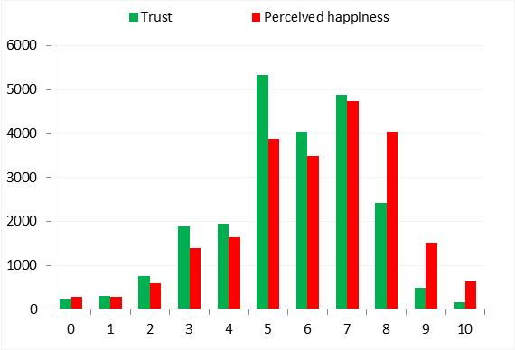
Distributions of trust and PH
N = 22,501

Slide 13
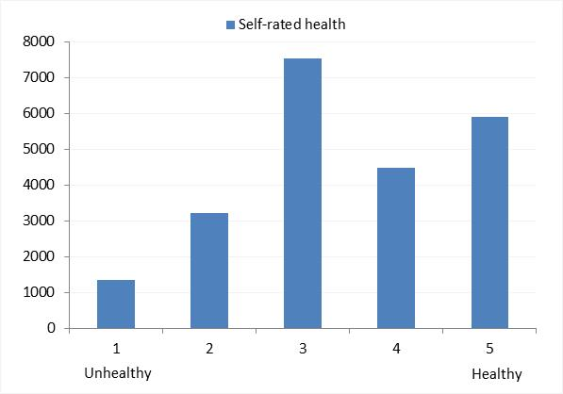
Distribution of SRH
N = 22,501

Slide 14
Key variables (2)
Construct binary variables to divide the respondents into groups of roughly-equal halves:
Higher trust
score ≥ 6 (covering 53.4%)
Higher perceived happiness
score ≥ 7 (covering 48.6%)
Better self-rated health
score ≥ 4 (covering 46.2%)

Slide 15
Controls (1)
Demographics
Sex; age (20s, 30s, 40s, 50s, 60s and over)
Marital status
Never married, married, divorced, widowed
Family variables
Having a kid(s); Residing with a parent(s)
and/or parent(s)-in-law

Slide 16
Controls (2): SES
Household spending
Household-size-adjusted
Educational attainment
Junior high school, high school, junior college,
college or above
Occupational status
Working, unemployed, out of labor force

Slide 17
Controls (3): Personality
Big five inventory
Asked in 1st wave
Five aspects of personality
extraversion, agreeableness, conscientiousness, neuroticism, and openness
Constructed from 44 items

Slide 18
Results for Question 1

Slide 19
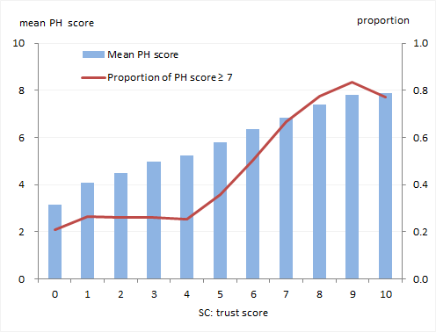
Positive association b/w trust and PH
N = 22,501

Slide 20
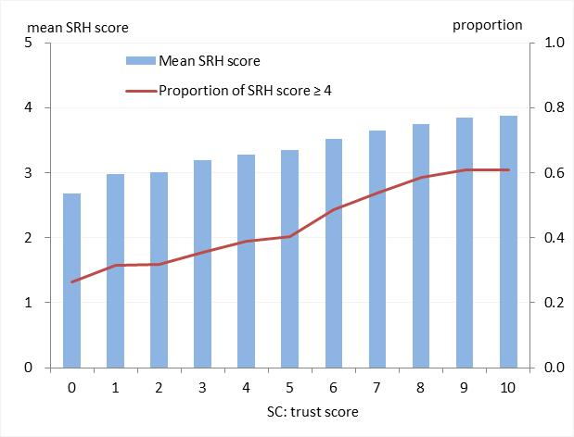
Positive association b/w trust and SRH
N = 22,501

Slide 21
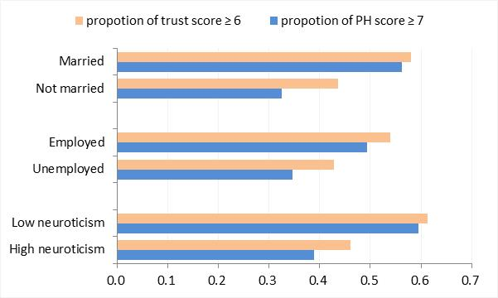
…. but the observed associations may be substantially attributable to other factors!
N = 22,501

Slide 22
Pooled OLS models
Dependent variable = PH score (range 0-10)
Independent variable = 1 (trust score ≥ 6)
Model Controlled for:
Model 1: sex, ages, and waves (benchmark)
Model 2: + marital status and family variables
Model 3: + SES
Model 4: + personality traits

Slide 23
Fixed-effects model
Dependent variable: PH score (range 0-10)
Independent variable: 1 (trust score ≥ 6)
Additionally control for time-invariant fixed-effects
Use data from three waves
Mean-centered FE model

Slide 24
Logistic models for pooled and panel data
Replace the linear dependent variable with 1 (PH score ≥ 7)
For fixed-effects models, use only respondents who experienced changes in PH scores across 7 at least once during the three waves.
Models 1-4 (pooled) and 5 (fixed-effects)

Slide 25
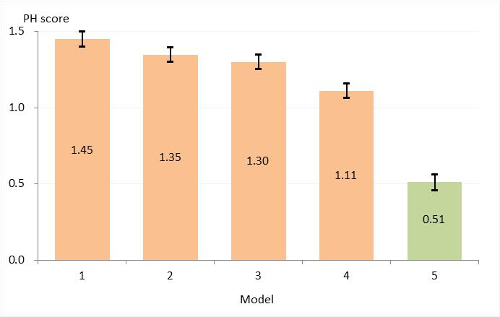
Results of linear models

Slide 26
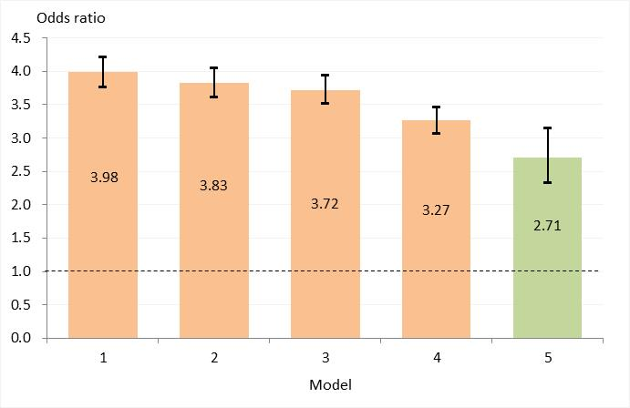
Results of logistic models

Slide 27
How about SRH?
Dependent variable
Linear models: SRH score (range 1-5)
Logistic models: 1 (SRH score ≥ 4)

Slide 28
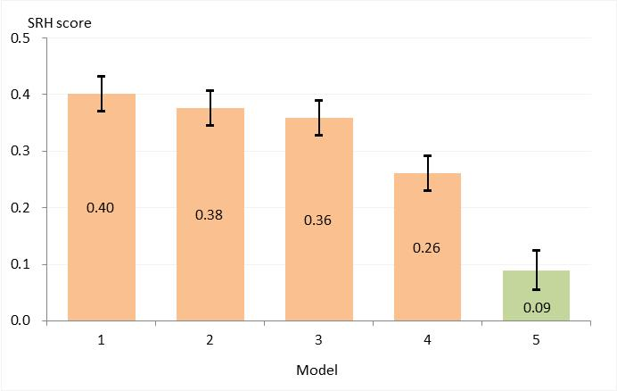
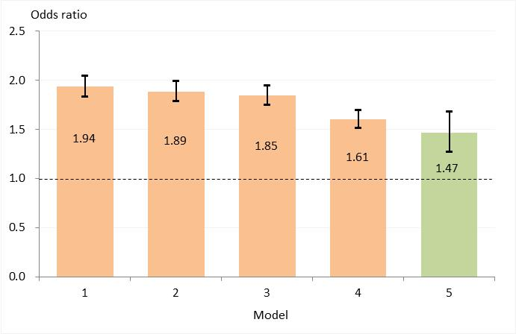
Similar results for SRH
Linear
Logistic

Slide 29
Results for Question 2

Slide 30
Construct area-level SC
It is often difficult to capture area-level SC, especially if SC is subjectively assessed.
One reasonable solution is to aggregate individuals’ assessments by averaging across individuals by area (Diez-Roux, 2007; Mujahid et al., 2007; Oshio and Urakawa, 2012).
But note that we cannot be free from the “same source biases” (Diez-Roux, 2007).

Slide 31
Focus on the first three digits of the postal code
E.g.
Correspond to the location of each local municipality.
In the original dataset, the total number of the three-digit areas was 885, and the number of respondents who lived in the same three-digit area ranged from 1 to 100 (M 23.4; SD 17.1).
6
1
6
8
0
1
5

Slide 32
Focus on the first three digits of the postal code (cont.)
Focus on areas with 20 residents or more.
Calculate the proportion of those who assess trust ≥ 6
Then, divide areas into higher- and lower-trust areas, taking the median (0.51) of the proportion of those who highly trust people as a cutoff point.

Slide 33
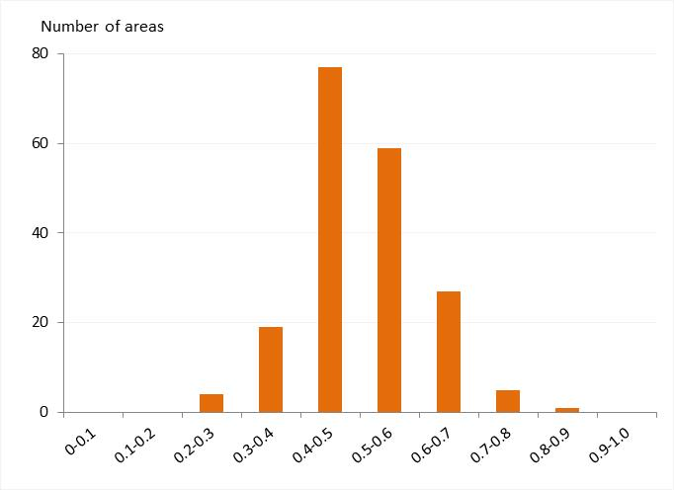
Distribution of proportions of those who highly trust people (# of areas =192)

Slide 34
Multi-level OLS/logistic models
Dependent variable:
PH score (range 0-10) or 1 (PH score ≥ 7)
Individual-level trust: 1 (trust score ≥ 6)
Area-level trust : 1 (higher trust)
Using data from the 1st wave only
Sample size: N = 5,033 (192 areas)
ICC very small (< 1%)

Slide 35
Multi-level OLS/logistic models (cont.)
Model Independent variable(s)
Model 6: Individual-level trust
Model 7: Area-level trust
Model 8: Individual-level trust + Area-level trust
(all models controlling for variables used in Model 4)

Slide 36
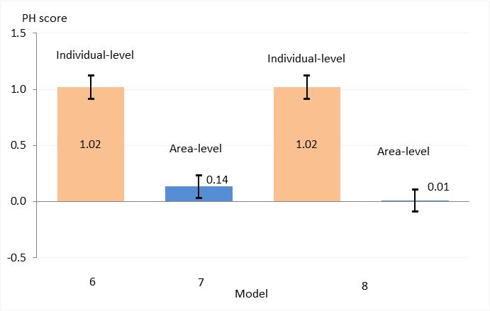
Results of multi-level OLS models

Slide 37
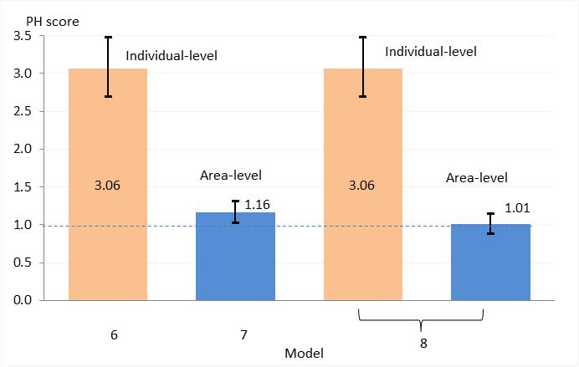
Results of multi-level logistic models

Slide 38
How about other SC variables?
Interactions with neighbors
- Frequency
- Wideness
Participation in social activities
- Regional activities (neighborhood groups and
associations)
Sports, hobby, and amusement activities
Volunteer, NPO, civic, and other similar types
of activities

Slide 39
Results of multilevel logistic models
PH is not associated with area-level trust, after controlling for individual-level trust.

Slide 40
Discussion and conclusion

Slide 41
Questions (again)
Question 1
Is the observed association between SC and PH real or spurious?
Question 2
Which is more relevant for PH, area-level SC or individual-level SC?

Slide 42
Re: Question 1 (1)
Findings: Controlling for marital status, family factors, socioeconomic factors, personality, and unobserved time-invariant fixed effects reduces the magnitude of the association by 65% (OLS) or 43% (logistic).
Suggest that the observed association between (individual-level) SC and PH is substantially overstated by other factors.

Slide 43
Re: Question 1 (2)
These results are reasonable, given that trust and PH in this study are both subjectively assessed by each respondent.
However, trust does matter. Its association with PH remains highly significant even after controlling for various potential confounders.

Slide 44
Re: Question 2
PH is much more closely associated with individual-level trust than area-level trust.
Three-digit areas may be too large to capture area-level variations.
Even if that is the case, results point to the risk that individual-level SC overstates the role played by SC, which is originally a contextual concept.

Slide 45
Future research issues (1)
Dynamism of SC
How is SC created, sustained, and strengthened by individuals/community?
SC is most likely to be endogenously determined by interactions with others.
With limited knowledge about the dynamism of SC, we should be cautious in using SC as an independent variable in regression.

Slide 46
Future research issues (2)
Relative importance of SC as a determinant or correlate of an individual’s subjective and objective well-being.
Can high SC offset low SES?
How much can we expect from SC, especially when we try to employ policy measures to enhance it?

Slide 47
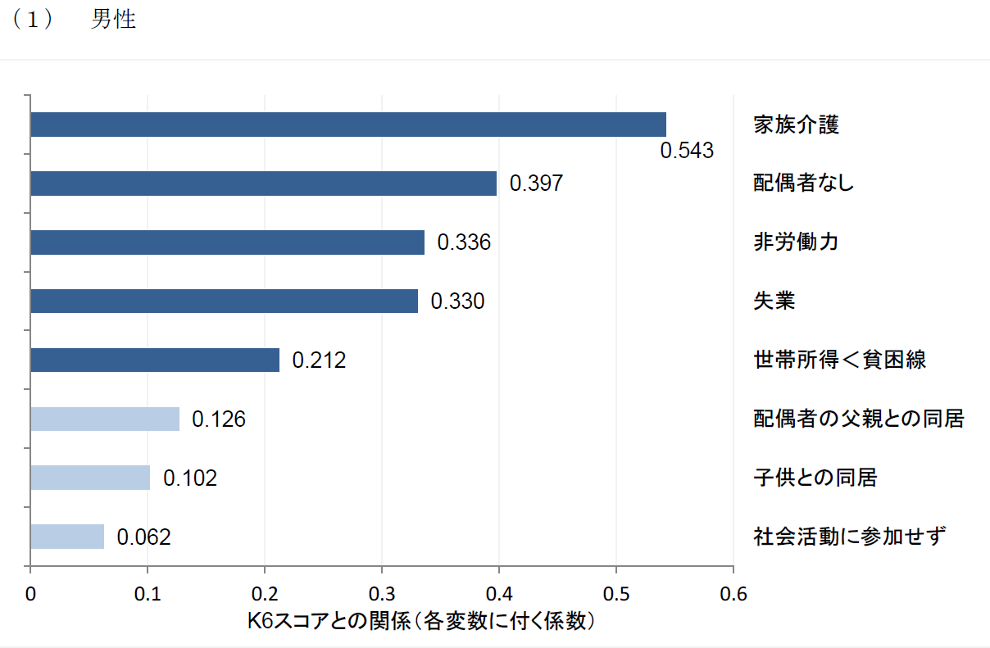
Appendix: Relative importance of SC for K6 scores (men) : fixed-effects model
(Oshio, 2014)

Slide 48
Relative importance of SC for K6 scores (women) : fixed-effects model
(Oshio, 2014)

Slide 49
Thank you for your attention!

